Slide 1
Recent Earthquakes:
Town Hall Meeting, June 26, 2014
Austin Holland, austin.holland@ou.edu
Amberlee Darold, adarold@ou.edu
Dr. G. Randy Keller, grkeller@ou.edu

Slide 2
Outline
Briefly address Induced Seismicity
Earthquakes, global/regional and local seismicity
Increased hazards and earthquake preparedness
EQ triggering: What we know and what we can say
Oil and Gas Technologies (OCC)
  Response to potential induced seismicity
Triggered/Induced seismicity by hydraulic fracturing and injection wells
Ongoing research and projects at the OGS
Recent earthquake swarms

Slide 3
Summary for potential induced seismicity
No documented cases of induced seismicity have ever come close to the current earthquake rates or the area over which the earthquakes are occurring
Long history of oil and gas activity and large number of wells require detailed research projects to identify induced seismicity
  The usual simple methods to identify potentially induced seismicity have only produced small numbers of identified cases
Potential cases of induced seismicity have been identified both from hydraulic fracturing and disposal wells
  Hydraulic fracturing only contributes a small amount to the observed rate of earthquakes
  Disposal wells are thought to be a larger contributor

Slide 4
What is an Earthquake?
When one body of rock slides past another
When this occurs seismic waves “sound” is generated
This sound radiates out in all directions and is what is measured at a seismic station
  The recording is a seismogram
  Waves are used locate and determine the size of the earthquake (magnitude)
  Contain much more information
In most earthquakes people feel the seismic wave

Slide 5
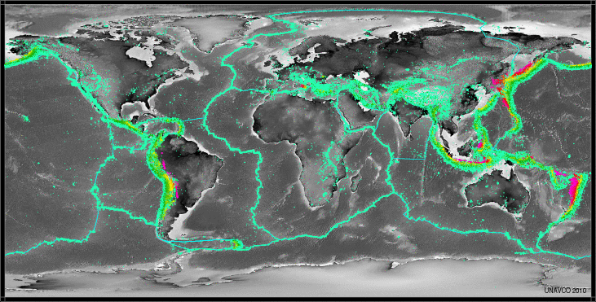
Earthquakes Worldwide

Slide 6
Mapped Faults in Oklahoma

Slide 7
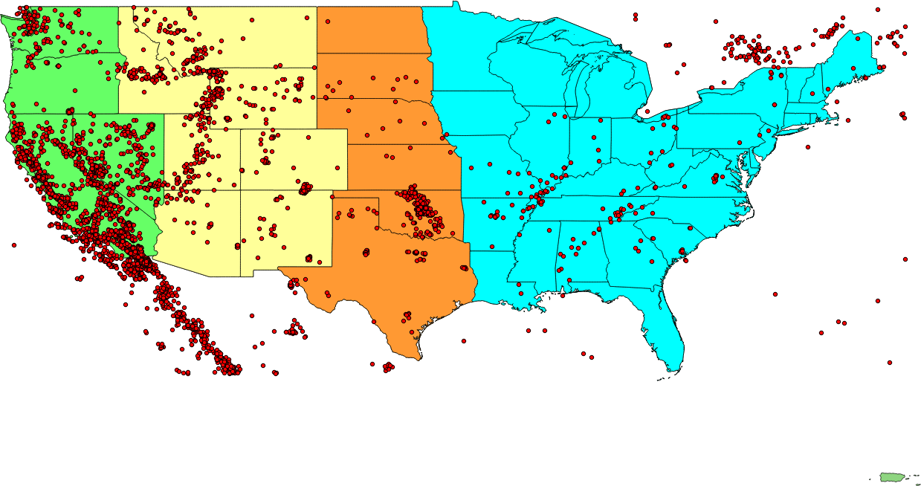
ANSS Earthquakes by Region

Slide 8
Earthquakes 1882-2013

Slide 9
Dramatic Increase in Oklahoma Earthquakes

Slide 10
Increased Seismic Hazard
Record Number of Oklahoma Tremors Raises Possibility of Damaging Earthquakes USGS/OGS Joint Press Release: 5/5/2014 11:30:00 AM
  “As a result of the increased number of small and moderate shocks, the likelihood of future, damaging earthquakes has increased for central and north-central Oklahoma.”
An increase like this has not been observed in modern seismology in an intra-plate setting
Modern seismology is young compared to geologic process of 10’s to 100’s of thousands of years
Increase is occurring over a very large area ~25,000 km²

Slide 11
Damaging Earthquakes in Oklahoma
The chances of a large damaging earthquake in Oklahoma are quite small
We can’t know when or where the earthquakes will occur or stop them
What we can do is prepare and understand what would be likely to occur in a damaging earthquake
Most earthquake damage is comprised mostly of damage to unreinforced masonry
Notes:
This slide was in my talks in 2010 and 2011 before the Prague earthquake

Slide 12

Earthquake Preparedness and Response
Red Dirt Ready
http://www.ready.gov/earthquakes
http://shakeout.org/centralus/
http://www.dropcoverholdon.org/
http://www.earthquakecountry.info/roots/index.php
http://www.okgeosurvey1.gov/pages/prepare.php
Notes:
Add red dirt ready

Slide 13


What to do and not do in an Earthquake
Don’t
Panic
Run from (exit) a building
  Most damage occurs to unreinforced masonry (brick and stone façade, chimneys)
  Wholesale building collapse is less likely
Get in a doorway
  Swinging doors can cause injuries
Notes:
Put what not to do in an EQ

Slide 14
Earthquake Triggering and Induced Seismicity
Natural Causes
Anthropogenic
Dynamically by the passage of seismic waves
Remote Triggering
Statically by local stress changes from previous earthquakes
  Small amounts of stress changes have been shown to trigger earthquakes
  as little as 2-7 psi
Natural fluid movement
  May be the cause of many aftershocks
Hydrologic loads
Reservoir Impoundment
Mining and Oil Production (Mass Removal)
Fluid Injection
Hydraulic fracturing
Geothermal Production
Physics of earthquake triggering and induced seismicity are well understood.
What is not well understood are the physical properties within the Earth that control when and where IS occurs.

Slide 15
Numbers of Documented Induced Seismicity Cases
Shemeta et al. TLE (2012) taken from:
National Research Council - Induced Seismicity Potential in Energy Technologies

Slide 16
Matt Skinner
Oklahoma Corporation Commission

Slide 17
Earthquakes Triggered by Hydraulic Fracturing
More readily identifiable than IS from long term injection
  At most 2% of wells and 10% of earthquakes
  Cannot explain most of the ongoing earthquake sequences
Cases have been documented in Ohio, Oklahoma, UK, British Columbia
  Mmax ~ 3.8
  Not expected to contribute to large numbers or large magnitudes of earthquakes
Opportunities for research
  May provide insight into state of stresses, properties, and processes within the Earth
  Increase in microseismic monitoring may help improve our understanding
  Much more geotechnical data possibly available

Slide 18
Earthquakes Triggered by Fluid Injection
Challenges
Opportunities
Earthquake rate changes over such a large area would be unprecedented (~25,000 km²)
Why now?
  Same technologies used for 60 years
More difficult to identify
  Not observing some of the typical behaviors of IS
Likely many cases of induced seismicity
  How do we sort out the cases that have the potential to advance our understanding?
With proper study triggered seismicity might be mitigated
Identifying critically stressed faults
New opportunities for research
  Multiyear multi-disciplinary collaborative project at OU
Much more geotechnical data possibly available

Slide 19
Triggered Seismicity from UIC Class II Wells
Disposal wells are recognized as the the greatest hazard
  Longer durations of injection
  Greater volumes -> greater magnitude?
EOR wells may be less of an issue because of the balance of volumes and pressures
Much more difficult to identify
  Large number of wells (Oklahoma)
    >4,000 disposal wells
    >5,000 EOR wells
  Injection occurs for a significant amount of time
  Less geotechnical information available vs production wells
  Globally, cases that have been identified generally involve individual wells
  The interaction of wells is unclear and requires further research

Slide 20
Disposal Wells
In Texas, Oklahoma, and Kansas the greatest volumes of waste-water come from produced water

Slide 21
Summary for potential induced seismicity
No documented cases of induced seismicity have ever come close to the current earthquake rates or the area over which the earthquakes are occurring
Long history of oil and gas activity and large number of wells require detailed research projects to identify induced seismicity
  The usual simple methods to identify potentially induced seismicity have only produced small numbers of identified cases
Potential cases of induced seismicity have been identified both from hydraulic fracturing and disposal wells
  Hydraulic fracturing only contributes a small amount to the observed rate of earthquakes
  Disposal wells are thought to be a larger contributor

Slide 22
Current Efforts
  Multiyear multi-disciplinary collaborative DoE funded project at OU ($1.8 million including cost sharing from industry and state agencies)
  Adding permanent and temporary seismic stations to the regional network
  Risk mitigation and management
Working with industry and other researchers to improve our understanding of
  Faults in Oklahoma
  Stress in the subsurface
Test whether the ”Traffic Light System” and other methods can work to manage/mitigate risk
Increased public outreach and education
OGS Resources
  http://www.okgeosurvey1.gov/pages/research.php
  http://www.okgeosurvey1.gov/pages/earthquakes/induced-seismicity.php

Slide 23
Logan and Northern Oklahoma County Seismicity
2013-2014
Earthquake sequences
(south to north):
Choctaw
Southern Arcadia Lake
Waterloo Road
Liberty Lake
Langston
Marshall

Slide 24
Choctaw Sequence

Slide 25
Choctaw Sequence (2010-present)
636 earthquakes located to date
26 events >= M3.0
92 events felt
Median depth of events are 6.8km or 4.2mi

Slide 26
Southern Arcadia Lake Swarm

Slide 27
Southern Arcadia Lake Swarm (2010-present)
565 earthquakes located to date
38 events >= M3.0
100 events felt
Median depth of events are 5.66km or 3.5mi

Slide 28
Waterloo Road Sequence

Slide 29
Waterloo Road Sequence (2010-present)
177 earthquakes located to date
9 events >= M3.0
50 events felt
Median depth of events are 5.0km or 3.1mi

Slide 30
Liberty Lake Sequence

Slide 31
Liberty Lake Sequence (2010-present)
386 earthquakes located to date
34 events >= M3.0
113 events felt
Median depths of events are 5.0km or 3.1mi

Slide 32
Langston Sequence

Slide 33
Langston Sequence (2010-present)
282 earthquakes located to date
30 events >= M3.0
52 events felt
Median depths of events are 5.0km or 3.1mi

Slide 34
Marshall Sequence

Slide 35
Marshall Sequence (2010-present)
60 earthquakes located to date
13 events >= M3.0
17 events felt
Median depth of events are 4.6km or 2.85mi

Slide 36
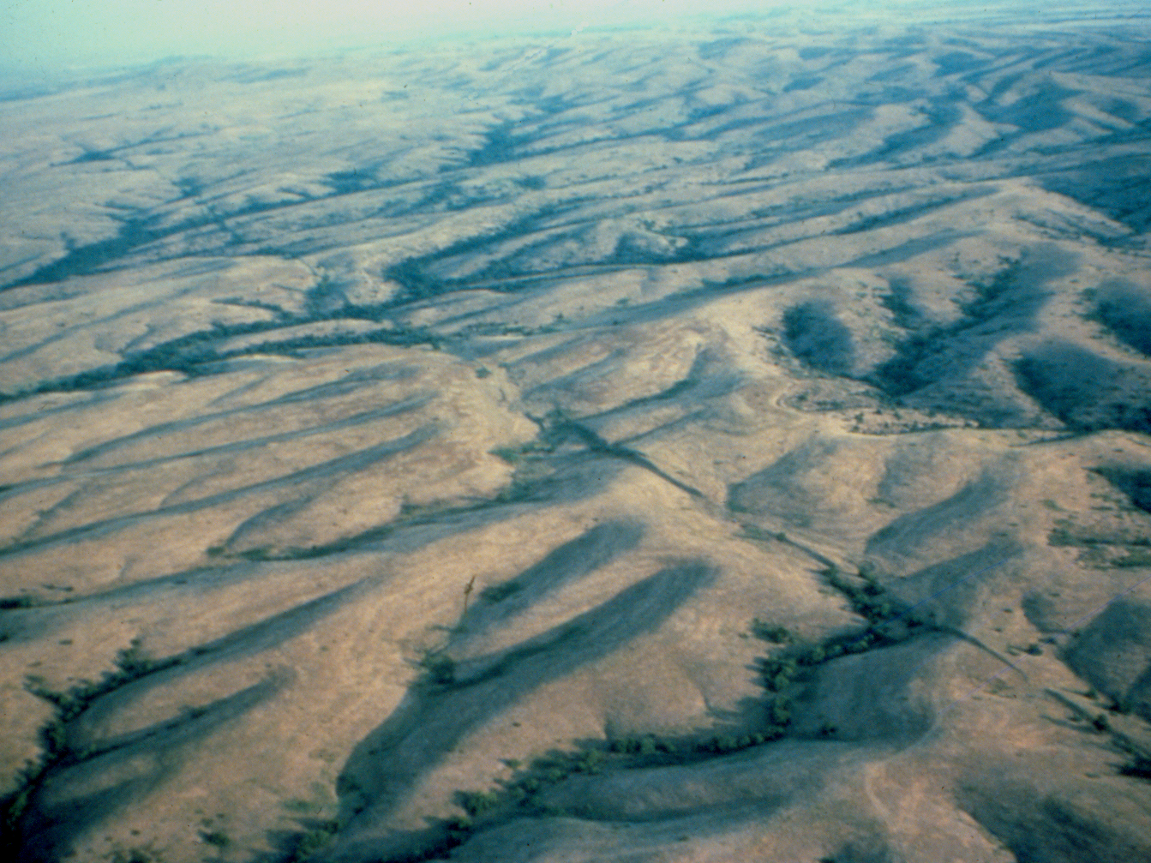
Questions?
Meers Fault, Southwestern Oklahoma
NW
NW
SE
SE
www.okgeosurvey1.gov
OGS Open File Report OF1-2014

Slide 37
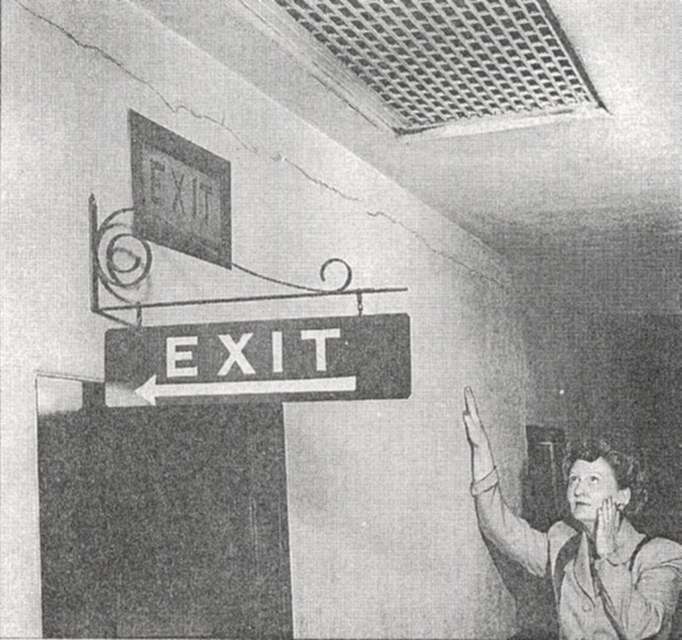
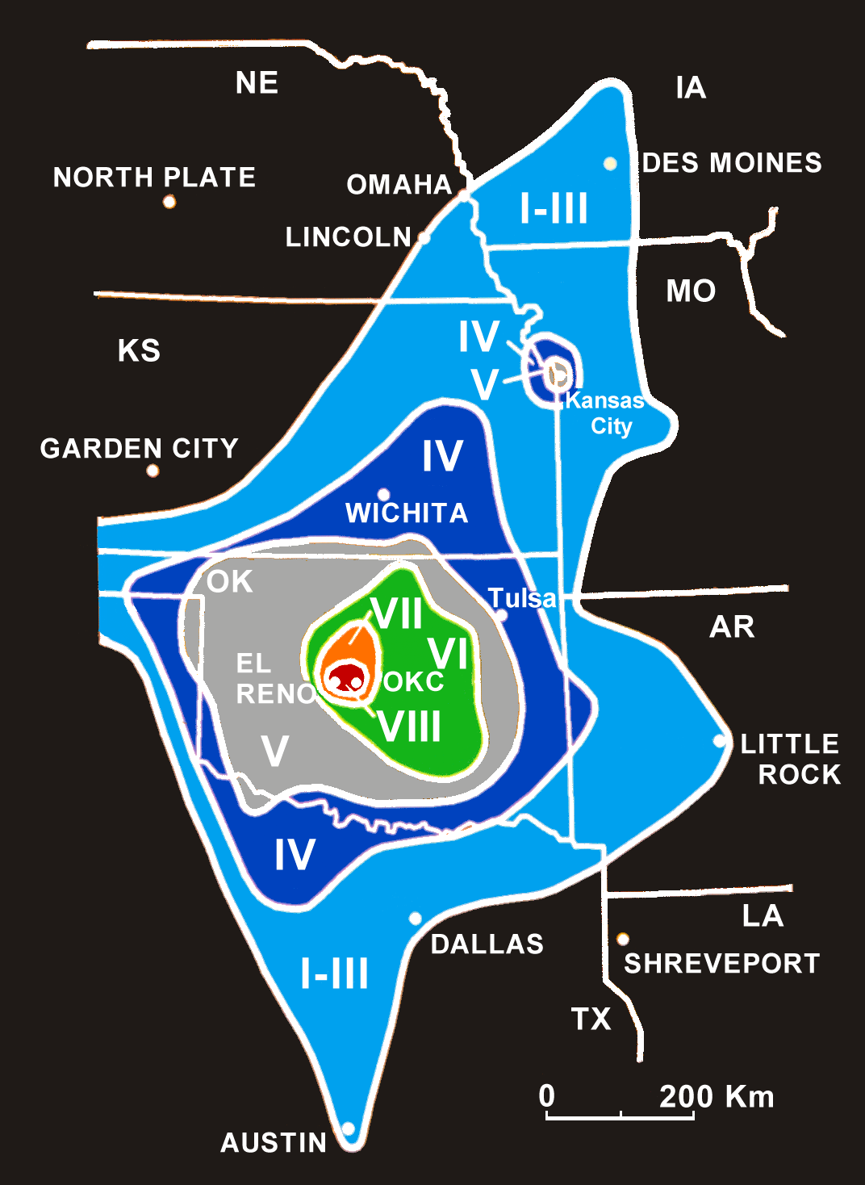
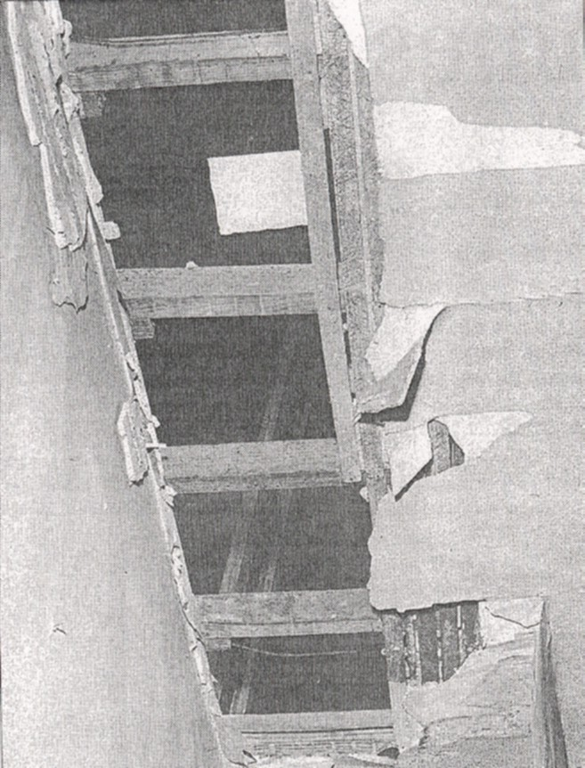
El Reno, April 9 1952

Slide 38
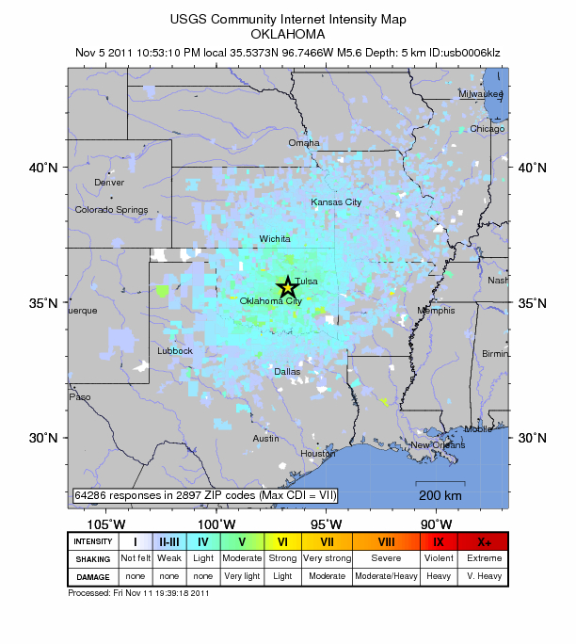
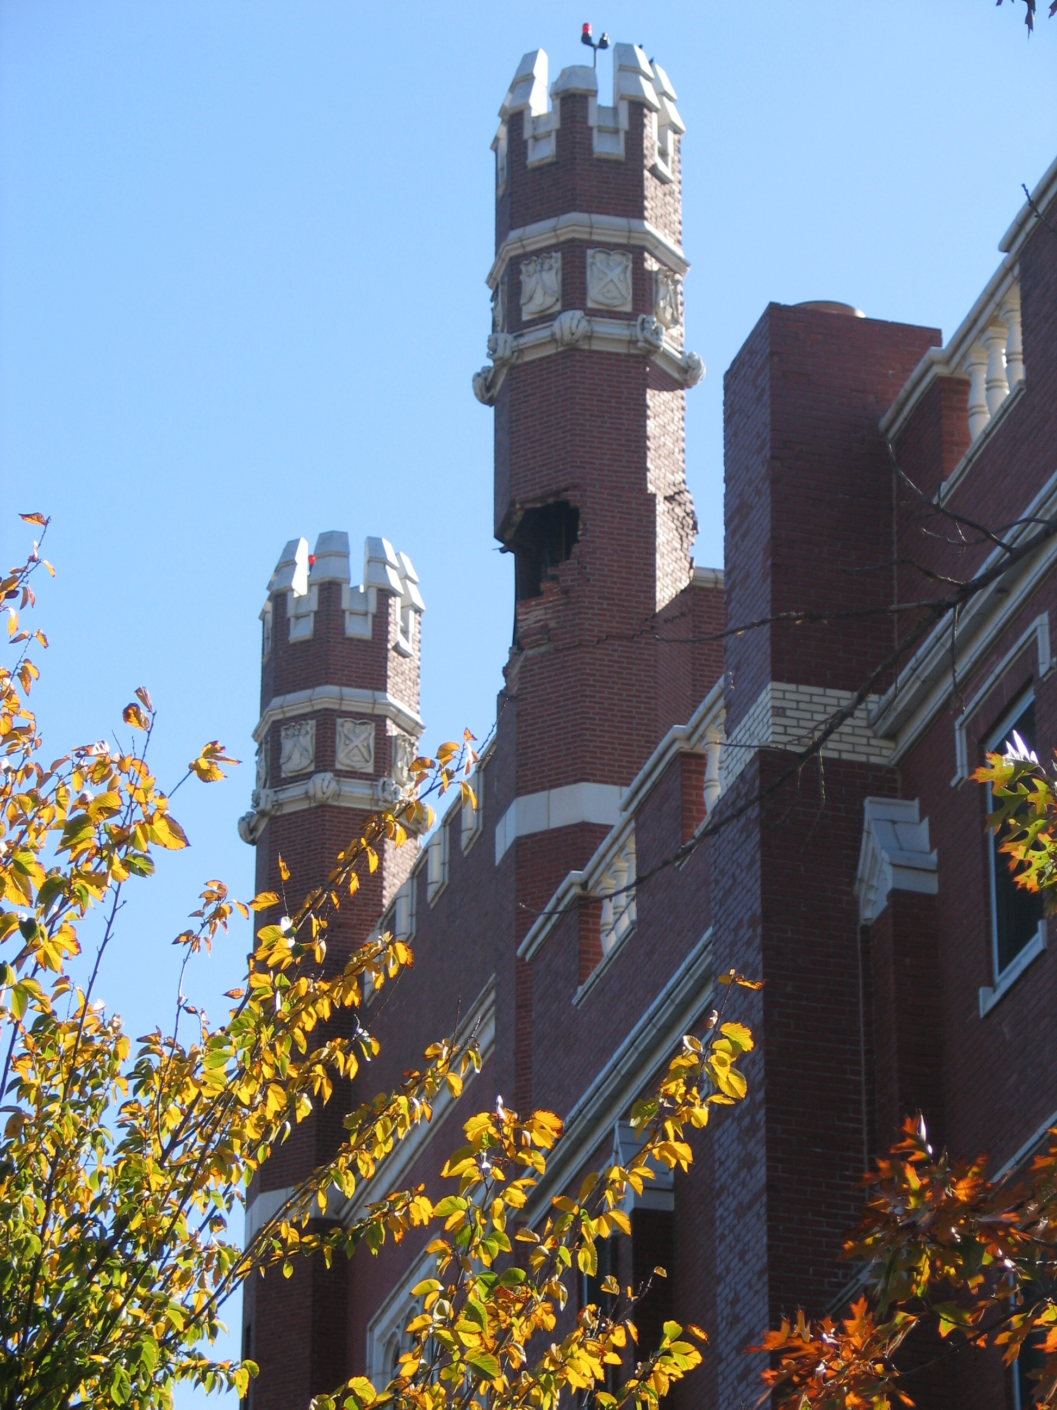
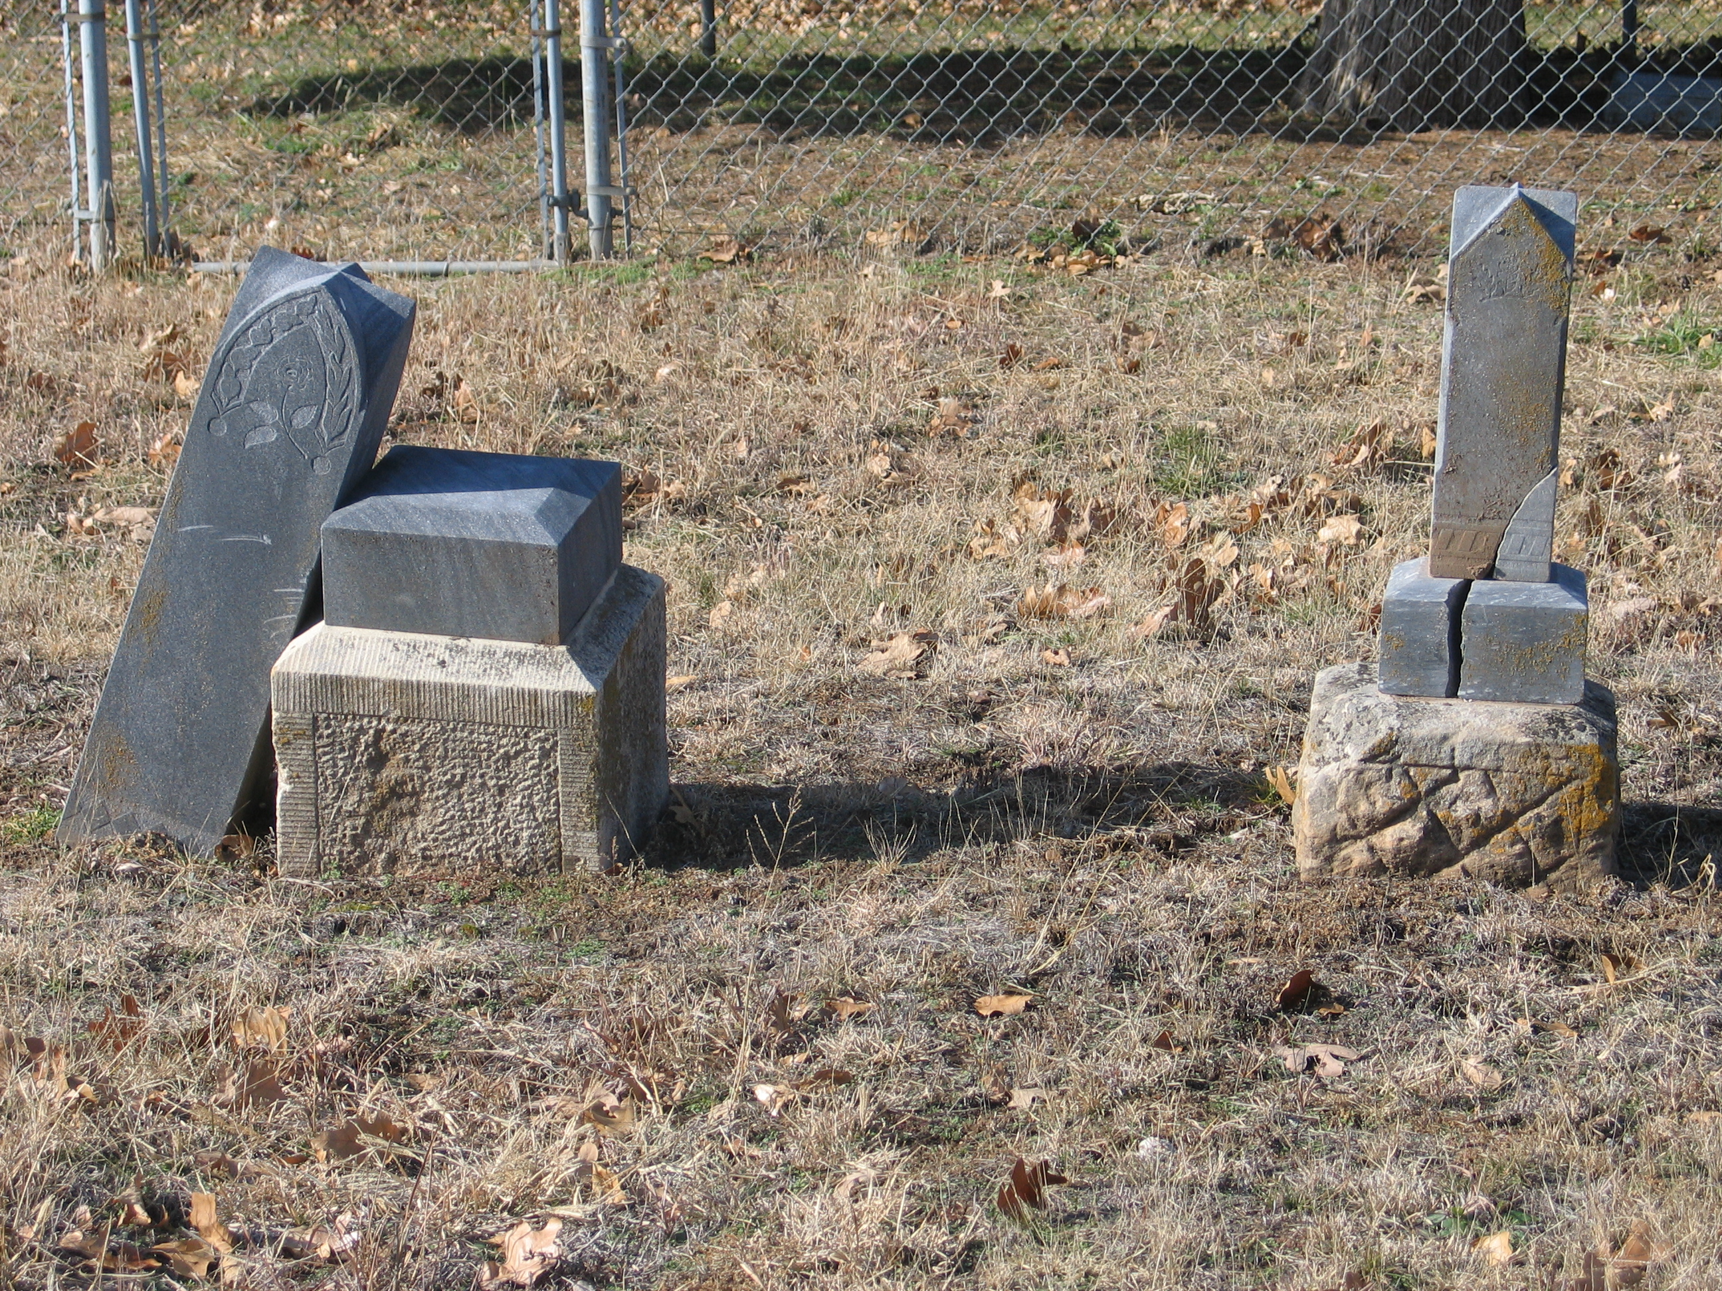
November 2011, Prague Earthquakes

Slide 39

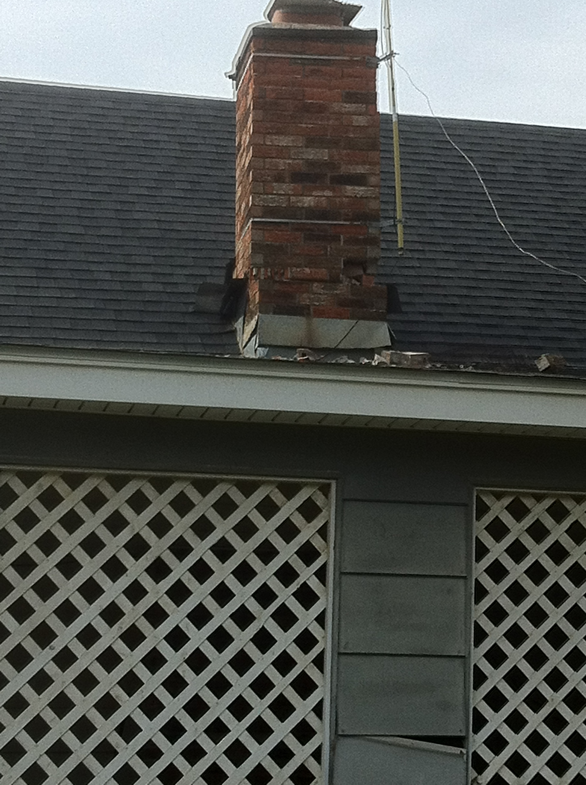
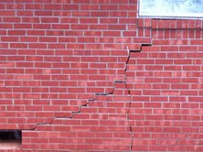
Damage to unreinforced masonry

Slide 40
Mid-continent increase primarily in Oklahoma
ANSS Catalog
Notes:
Seismicity rates are not constant through time.

Slide 41
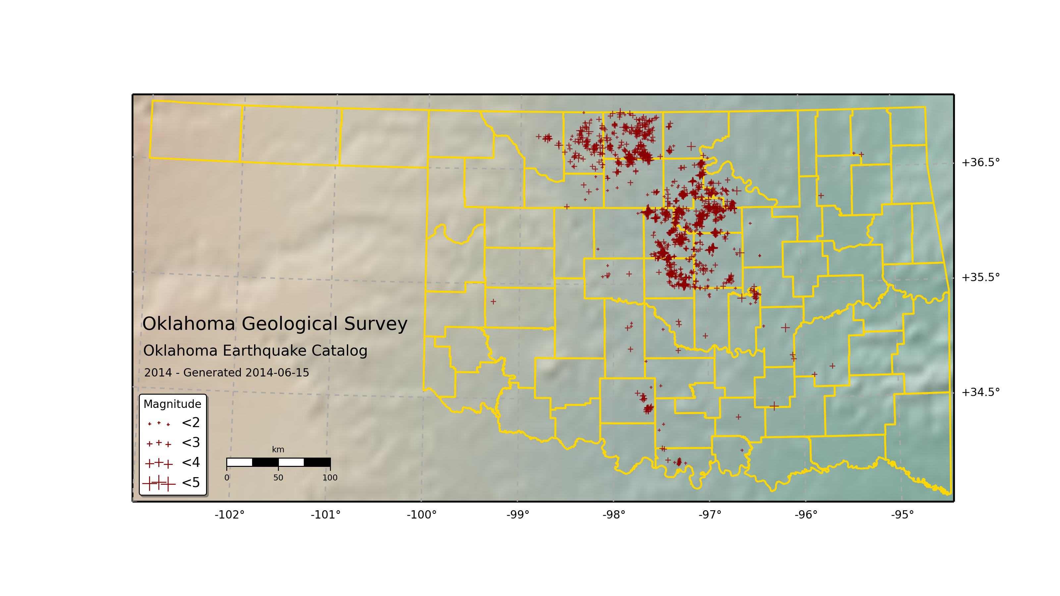
Earthquakes 2014

Slide 42
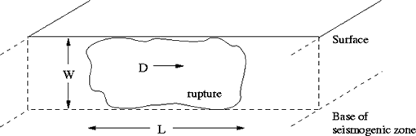
Measuring an Earthquake: Magnitude
Source: USGS
Magnitude is proportional to rupture area and slip on fault
  Log measure of the energy released as seismic waves
  1 Magnitude unit is ~32 times more energy release
Cannot be directly measured inferred from measurements at surface

Slide 43
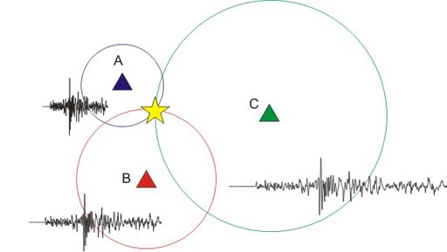
Earthquake Locations
Earthquake locations contain uncertainty
  Some more than others
Factors controlling location accuracy
  Station very near earthquake (depth)
  How many stations are close to earthquake
  Understanding of velocity distributions within the Earth
Source: BGS
Oklahoma has a good regional network (may not be adequate to assess specific cases of IS)
Horizontal uncertainties are about 8 km with uncertainties .1 to 15 km
Vertical uncertainties .1 to unconstrained

Slide 44
Earthquake Triggering
How?
General Observations
Most of the Earth’s crust is near failure
Magnitudes tend to increase with time or injected volume
Earthquakes may start close to a well and migrate outward
Earthquakes may show temporal correlation to injection
Increase in shear stress
  Mass changes
  Permeability barriers
  Thermal changes
Increase in pore pressure
  Fluid injected under pressure
  Fluid injected under little or no pressure can generate a hydraulic head (100 m head ~ 1 MPa)

Slide 45
Induced Seismicity from Fluid Injection
Increased pore pressure from fluid injection effectively reduces friction on fault
  Or in Mohr-Coulomb space moves the circle towards failure
Pore pressure can be increased even injecting on vacuum
  Hydraulic head
τ
σ_{n}
Failure
τ
τ_{o}
σ_{i}
Add Pore Pressure
p
  σ₁-σ₃
Notes:
Size of the Mohr-Coulomb circles are the deviatoric stress sigma1-sigma3
Of course pressure doesn’t instantaneously increase as shown here, but how does it propogate within the Earth

Slide 46
Pressure Diffuses Within the Earth
Pressure increase is not due to actual fluid flow
  Can be much more rapid
  Because water is fairly incompressible it is similar to an elastic response although slower
  Diffusivity constant is
    T = transmissivity
    S = storativity
  Proportional to permeability
Pressure increases over time
Talwani et al. (2007) J. Geophys Res.
Notes:
Top figure shows the time progression of pressure from an injection well injecting at a constant pressure
Bottom figure shows the range of diffusivity observed in most cases of induced seismicity

Slide 47
Injection by Formation
Vast majority of disposal by volume is not frac waste-water but produced water (part of producing oil and gas)
Large number of Arbuckle wells injecting on vacuum for years

Slide 48
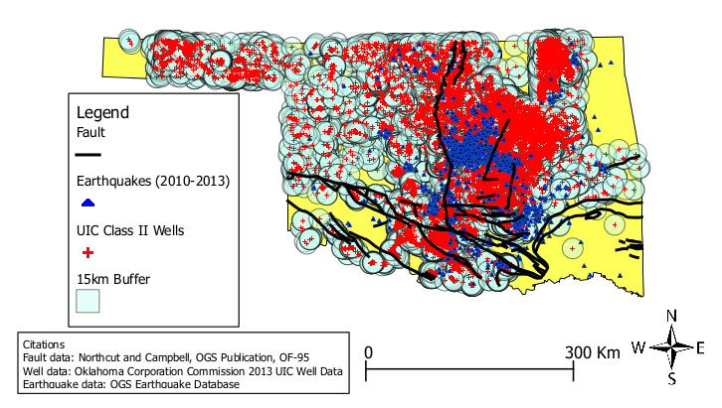
All UIC Class II Wells
99% of all earthquakes 2010-7/2013 occur within 15 km of a well
85% of Oklahoma’s area is within 15 km of a well
Have to move beyond simple spatial correlations
Notes:
About 80% of the entire area of the state of Oklahoma is within 15 km of UIC Class II well

